Slide 1
Expedited Project Development
Making the Most out of Right of Way Showings

Slide 2
A Tale of Two Projects
11-185.00 US 25E Laurel County 11-188.00 US 25E Knox County
ADT – 26,148 ADT – 23,380
Access Management, Access Management, Signal Relocation &
Signal Relocation, Pavement Rehab Elimination, Pavement Rehab

Slide 3
41 Parcels 21 Appraisals, 20 MAR 16 Commercial, 4 Residential & 1 Farm 3 Relocations – All Business

Slide 4
ROW Work Structure
Project Report
Onsite Field Review with ROW Staff, Review Appraiser and Design Project Manager after final plans were received
Sales Book
All Appraisal Staff compiled sales information together along with review appraiser
Minor Acquisition Review
Data used from Sales Book coupled with individual parcel inspection (i.e. fences, asphalt, etc.)

Slide 5
ROW Work Structure
Property Owner Contacts
Notification of upcoming meeting only
Right of Way Plan Showing (Property Owners Only)
Scheduled Offer to Purchase Meetings Early
Scheduled Remaining Property Owners in Afternoon
Appraisals Completed
Continued working closely with the reviewer
Scheduled relocation parcels first
Results???

Slide 6
Results
11 Offers to Property Owners and 2 were signed
ROW Clear within 1 year
Letting Date was never moved
Only 6 Condemnations
Lots and Lots of Experience

Slide 7
Lessons Learned
What we felt worked well:
Joint ROW and Design Field Review – Immediate evaluation of impacts, Plan Omissions, Parcel Elimination
Offer to Purchases at Public Meeting – Meeting went well, but we thought results could be improved
What we thought could be improved:
More and Earlier Property Owner Contact
Plan review earlier in the process
Eliminating Duplicate Work – Same sales data for appraisals had to be entered multiple times due to being used by multiple appraisers

Slide 8
Project Challenges

Slide 9
Censorship!!!

Slide 10
They Moved…But to Where??

Slide 11
53 Parcels 23 Appraisals, 30 MARS 23 Commercial 0 Relocations

Slide 12
Kept Same ROW Work Structure With Exceptions
Draft ROW Plans used for Project Report
Sped up meeting time and eliminated a required revision.
Ultimately led to better plans as a result of collaboration and better communication
Better Plans Faster to Sign or Sue Faster to Letting
Joint Design/ROW Field Review
Examples

Slide 13
Eliminated Parcels

Slide 14
Eliminated Parcels

Slide 15
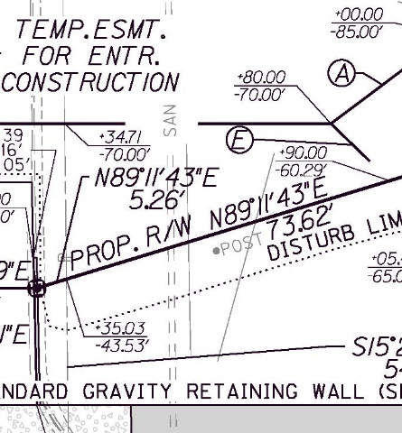
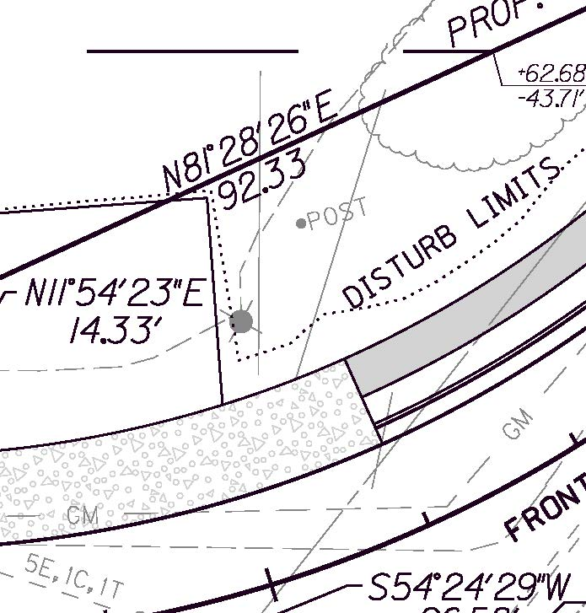
Misidentified Plan Information

Slide 16
Post???

Slide 17
Plans Corrected to Show Public ROW

Slide 18
Plans Corrected to Show Public ROW

Slide 19
Plans Corrected to Show Public ROW

Slide 20
KY Supreme Court Decision Affecting ROW
ELLINGTON v. BECRAFT - Decided December 14, 2017 - Refines case law to better define how roads are established.
County Roads are “public roads” which have been formally accepted by the fiscal court as a part of the county road system (requires a formal action by the county)
Public Roads are informal dedications (no action by any governmental agency) that can be completed in two ways.
Estoppel - based upon promises (either express or implied) and reliance thereon by the public.
Prescription – Ruled to be the same as adverse possession. Must meet all requirements (i.e. a prescriptive easement can be acquired by actual, hostile, open and notorious, exclusive, and continuous possession of the property for the statutory period of fifteen years)

Slide 21
Result of Public Road Recognition
Fee Simple Acquisition was reduced by 73,752 SF
Greater than $300k savings to KYTC
Property owner reaction is mixed

Slide 22
Sales Data Pilot Program Same sales data had to be entered multiple times.

Slide 23
Eliminating Duplicate Work

Slide 24
Implemented Mandatory Property Owner Involvement in MAR Process
Created a consistent approach
MARS follow similar process as Appraisals from a property owner perspective
Allowed for Property Owner Concerns to be addressed
Plan Omissions, Entrance Changes (Not Enhancements), Etc.
Opportunity to see plans and discuss
Allowed for reflection on work being done and questions to be asked prior to the meeting while ROW Plans were being finalized

Slide 25
Offer to Purchase ROW Showing
Scheduled specific meeting times with MAR parcels
All other property owners were given a conventional meeting time
Participants:
ROW Staff – Including agents, supervisor, review appraiser and CO staff (with administrative settlement authority)
Design Staff – Project Manager, Design Consultant and Utility Representative
Personal relationships established during MAR process paid off

Slide 26
Results
Made 14 Offers to Purchase (All were MARs)
Signed 9 on meeting day and one additional a couple days later
Kick-off for Appraisals
Made appropriate contacts for affected businesses and discussed their concerns

Slide 27
Lessons Learned
Project Applicability
Must have high percentage of MARs
MAR property owners shouldn’t also have appraisals
MAR parcels must have local signatory authority (availability to be present)
Cross-Discipline communication and teamwork is crucial
Early Property Owner involvement in the MAR process shows significant results

